Slide 1
Streamline Message with GCP Pub/Sub
Solution Proposal
Joydeep Das
Version 1.0 Aug, 2020

Slide 2
Agenda
Purpose
Scope
Current Application Landscape
Target Landscape Cartography
Assumptions/Decisions
Queries

Slide 3
Purpose
Background:
Nicolab has embarked on a key initiative to reduce infrastructure & related costs and utilize investment by creating GCP project to build the container for the main service, The deployment of the project have two separate cluster of activities –
use the available terraform file in the repository to deploy the infrastructure. This will build two storage buckets
based on events need to update the second storage bucket while maintaining the first bucket as main source of truth
Goal:
Solution Design to cover the future state of this environment in the GCP. The solution needs to:
Setup GCP account while enabling the necessary APIs (Cloud Build, Cloud Run), build the container for the main service
Define logic to process these events in such a way that the order in which we receive/process the events will not affect the end result.

Slide 4
Scope
Build the Infrastructure
Setup GCP account while enabling the required API’s
Deploy the infrastructure using the terraform code
Event triggered uniquely identified message
Solution design logic

Slide 5
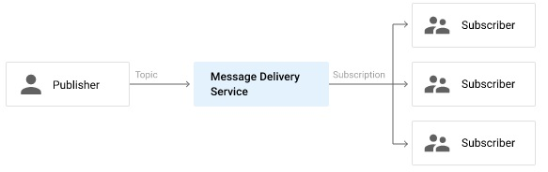
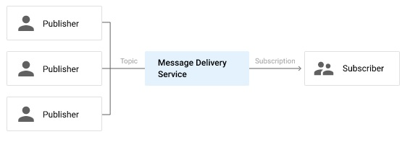
Current Application Landscape
Scene - 1
Scene - 2
In both the scenarios, event messages are not ordered as -
It is possible to receive duplicate messages.
It is possible to receive old (delayed) messages.
Messages are not received in order

Slide 6
Target Solution Design
In order to process messages in order, a subscriber must either have following solution options:
Solution option 1: Know the entire list of outstanding messages and the order in which they must be processed
Solution option 2: Determine from all messages it has currently received whether or not there are messages it has not yet received that it needs to process first
Solution 1 steps –
By assigning each message a unique identifier and storing in some persistent place (such as Cloud SQL) the order in which messages should be processed.
A subscriber would check the persistent storage to know the next message it must process and ensure that it only processes that message next, waiting to process other messages it has received when they come up in the complete ordering.
At that point, it is worth considering using the persistent storage itself as the message queue and not relying on message delivering through Pub/Sub
Solution 2 steps –
By using Cloud Monitoring to keep track of the pubsub.googleapis.com/subscription/oldest_unacked_message_age metric
A subscriber would temporarily put all messages in some persistent storage and ack the messages
It would periodically check the oldest unacked message age and check against the publish timestamps of the messages in storage
All messages published before the oldest unacked message are guaranteed to have been received, so those messages can be removed from persistent storage and processed in order

Slide 7
Assumptions
Both storage buckets are already existing as part of terraform deployment
GCP pub/sub event is triggered to store messages on 1st bucket( main source of truth)
Integrating Pub/Sub with cloud run services.
Decisions
Using Cloud Monitoring to keep track of the message age and check against the publish timestamps of the messages in storage as depicted in Solution option 2

Slide 8
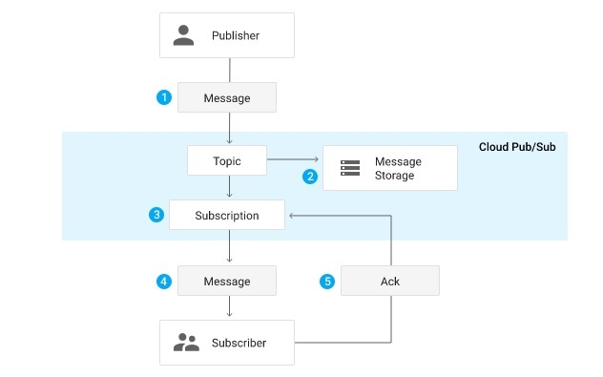
Pub/Sub Message Flow
A publisher application creates a topic in the Pub/Sub service and sends messages to the topic. A message contains a payload and optional attributes that describe the payload content
The service ensures that published messages are retained on behalf of subscriptions. A published message is retained for a subscription until it is acknowledged by any subscriber consuming messages from that subscription.
Pub/Sub forwards messages from a topic to all of its subscriptions, individually
A subscriber receives messages either by Pub/Sub pushing them to the subscriber's chosen endpoint, or by the subscriber pulling them from the service.
The subscriber sends an acknowledgement to the Pub/Sub service for each received message.
The service removes acknowledged messages from the subscription's message queue.

Slide 9
Solution implementation details
Solution implementation –
Node.js based subscriber implementation is available at –
https://github.com/googleapis/nodejs-pubsub/blob/master/samples/listenForOrderedMessages.js

Slide 10
Thank You

